Slide 1
China + HK insights
Overnights Finland
Digital Demand – Travel Related Internet Searches
Forward Keys – Flight bookings and Capacity data
Oxford Economics – Recovery Forecast

Slide 2
China + HK– overnights in Finland 2011-2021
Continuous growth
2021
23,000 nights
YoY change -76%
2019 441,000 nights
2021 vs. 2019 -95%
Link to the report: Tilastopalvelu Rudolf - Business Finland
Source: Visit Finland Statistics Service Rudolf, Statistics Finland

Slide 3
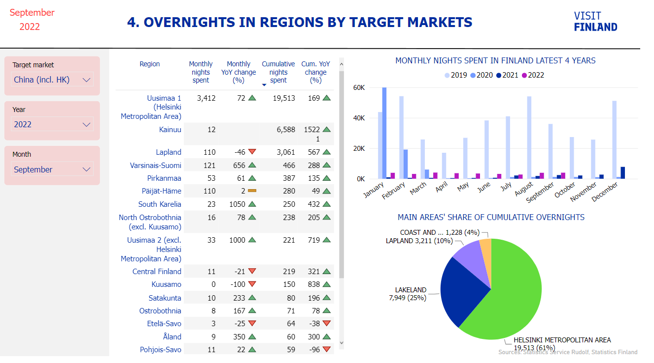
China + HK – overnights in Finland 2022
Despite the low volumes, Helsinki is the biggest greater area for Chinese visitors this year with over 19 000 nights (61% of total share)
Link to the report: Tilastopalvelu Rudolf - Business Finland
Source: Visit Finland Statistics Service Rudolf, Statistics Finland

Slide 4
Top markets in winter season 2022
And change compared to pre-pandemic
High winter season (12-02)
Top destinations from China + HK
 | Dec2018-Feb2019 | Dec2021-Feb2022 | Change 2022 vs. 2019
United Kingdom | 334 900 | 278 600 | -17 %
France | 161 700 | 180 300 | +11 %
Germany | 151 300 | 133 100 | -12 %
Netherlands | 106 700 | 111 300 | +4 %
Spain | 59 400 | 55 300 | -7 %
Estonia | 58 200 | 47 400 | -19 %
Belgium | 30 300 | 45 900 | +51 %
Italy | 42 900 | 45 200 | +5 %
United States | 53 800 | 39 600 | -26 %
Switzerland | 51 800 | 37 800 | -27 %
Sweden | 75 100 | 30 200 | -60 %
Poland | 21 900 | 21 500 | -2 %
Denmark | 21 200 | 17 100 | -20 %
Russia | 261 300 | 16 100 | -94 %
Austria | 19 500 | 15 900 | -18 %
China & Hong Kong | 139 700 | 14 800 | -89 %
Winter 2022
Helsinki | 3 600
Vantaa | 3 300
Sotkamo | 2 500
Rovaniemi | 2 000
Inari (Saariselkä) | 1 100
Winter 2019
Helsinki | 35 200
Rovaniemi | 35 000
Inari (Saariselkä) | 16 500
Vantaa | 10 000
Sotkamo | 9 300
Source: Visit Finland Statistics Service Rudolf, Statistics Finland

Slide 5
Top markets in summer season 2022
And change compared to pre-pandemic
High summer season (06-08)
 | Jun-Aug2019 | Jun-Aug 2022 | Change 2022 vs. 2019
Sweden | 255 200 | 235 800 | -8 %
Germany | 270 300 | 229 100 | -15 %
United States | 109 900 | 103 800 | -6 %
United Kingdom | 90 800 | 74 500 | -18 %
Norway | 73 400 | 68 200 | -7 %
Estonia | 69 400 | 60 400 | -13 %
Russia | 243 400 | 60 100 | -75 %
Switzerland | 64 400 | 54 100 | -16 %
France | 64 100 | 53 800 | -16 %
Netherlands | 62 300 | 52 400 | -16 %
Italy | 68 200 | 45 700 | -33 %
Spain | 56 600 | 41 800 | -26 %
Poland | 31 400 | 35 500 | +13 %
Denmark | 37 700 | 34 200 | -9 %
Austria | 27 900 | 22 400 | -20 %
Belgium | 21 500 | 19 900 | -7 %
Top destinations from China + HK
Summer 2022
Helsinki | 4 400
Vantaa | 1 900
Sotkamo | 1 100
Espoo | 600
Turku | 200
Summer 2019
Vantaa | 50 900
Helsinki | 45 000
Espoo | 5 400
Rovaniemi | 3 600
Lohja | 3 500
China and Hong Kong 133 300 9 800 -93%
Source: Visit Finland Statistics Service Rudolf, Statistics Finland

Slide 6
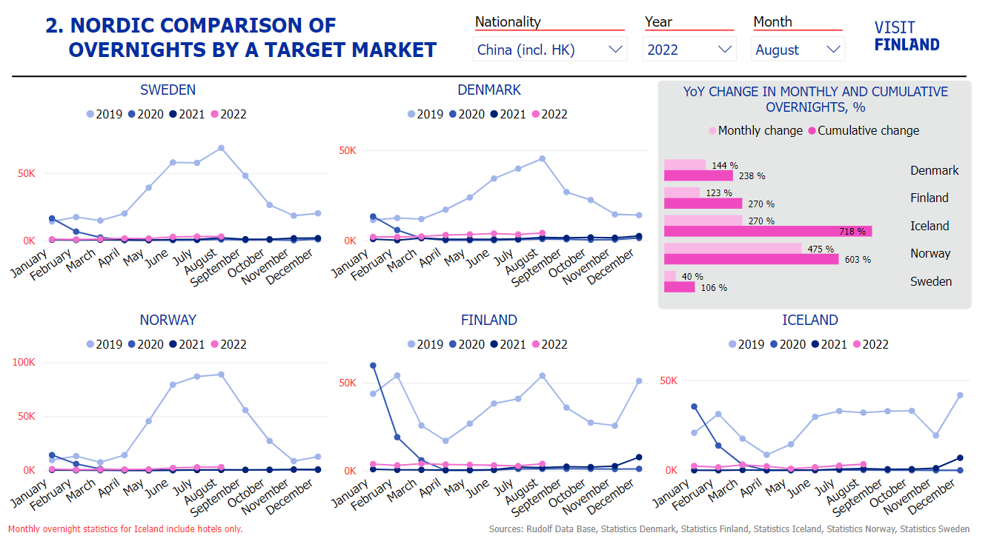
China + HK – Overnights in Nordics
Link to the Nordic report: Pohjoismainen vertailu - Business Finland
Sources: Visit Finland’s Statistics Service Rudolf, Statistics Finland,
Statistics Denmark, Statistics Iceland, Statistics Norway and Statistics Sweden

Slide 7
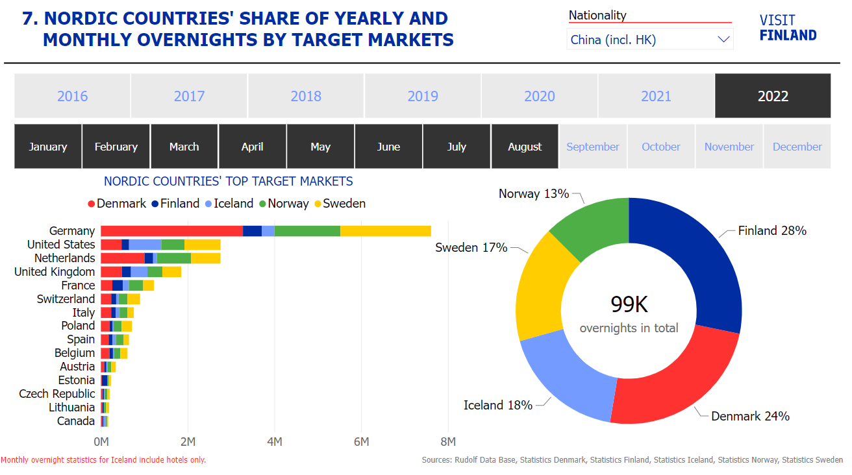
China + HK – Overnights in Nordics
Link to the Nordic report: Pohjoismainen vertailu - Business Finland
Sources: Visit Finland’s Statistics Service Rudolf, Statistics Finland,
Statistics Denmark, Statistics Iceland, Statistics Norway and Statistics Sweden

Slide 8
Digital Demand – Travel Related Internet Searches
Q1-Q3 2022

Slide 9
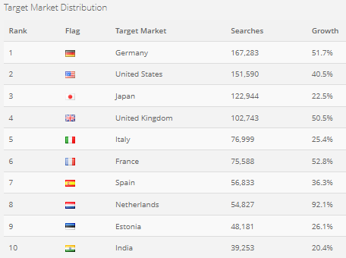
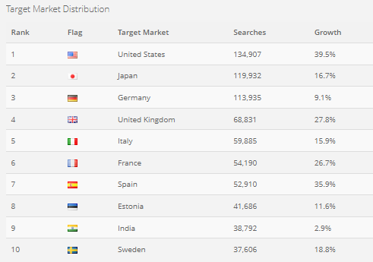
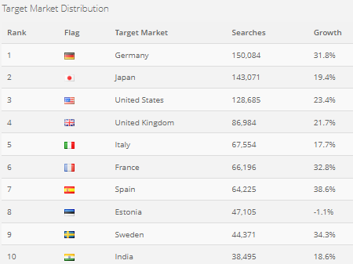
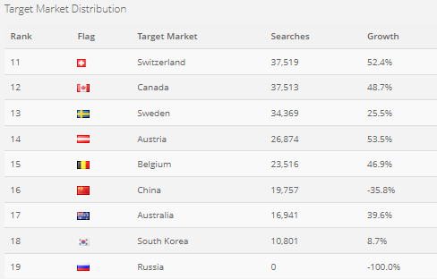
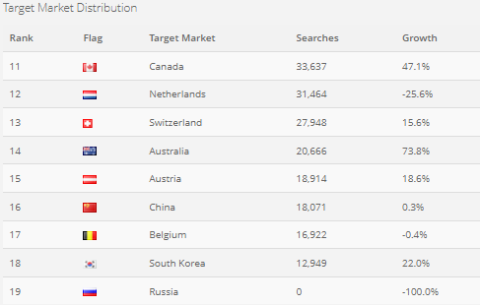
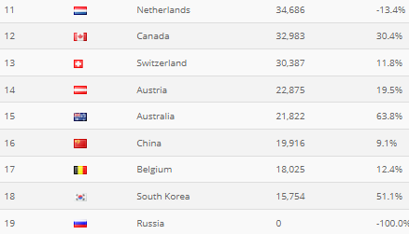
China: Searches Q1-Q3 2022
Q1/2022
Q2/2022
Q3/2022
Source: D2 Digital Demand

Slide 10
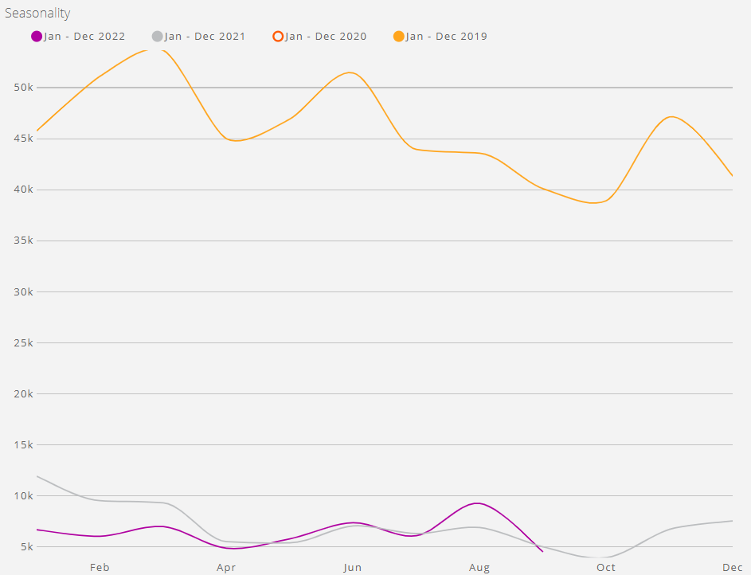
China: Seasonality of Searches
2019, 2021 and 2022

Slide 11
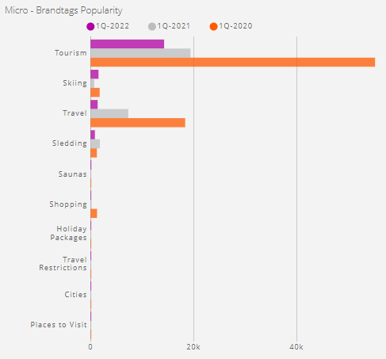
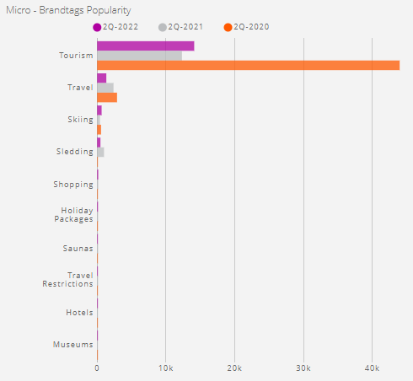
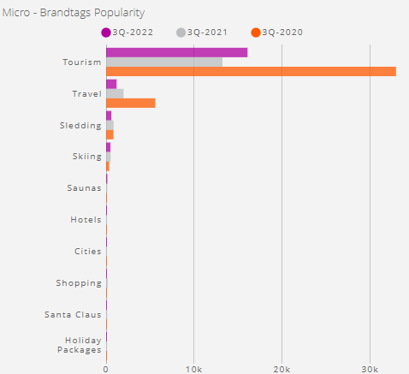
China: Most searched topics
Q1-Q3 2020-2022
Q1/2022
Q2/2022
Q3/2022
Source: D2 Digital Demand

Slide 12
ForwardKeys Seat capacity to Finland
November/2022 – February/2023

Slide 13
Direct flights to Finland November 2022 - February 2023
and change in seat capacity compared to pre-pandemic
From | To | Average weekly frequency
Tokyo (HND) | HEL | 12 → 14
Doha (DOH)** | HEL | 3 → 14
Bangkok (BKK) | HEL | 11
Singapore (SIN) | HEL | 7
Delhi (DEL) | HEL | 7
Seoul (ICN) | HEL | 5-6
Hong Kong (HKG) | HEL | 3
Dubai (DUB) | HEL | 3
Mumbai (BOM) | HEL | 3
Phuket (HKT) | HEL | 1 → 5
Tokyo (NRT) | HEL | 2
Shanghai (PVG) | HEL | 2
Chengdu (CTU) | HEL | 1
Guangzhou (CAN) | HEL | 1
Asia
72 avg. weekly flights
(Share; %YoYPP Var)
(13%; -46%)
USA
16 avg. weekly flights
(Share; %YoYPP Var)
(3%; +16%)
Europe
985 avg. weekly flights
(Share; %YoYPP Var)
(84%; -21%)
From | To | Avg. weekly frequency
New York (JFK) | HEL | 7
Dallas (DFW) | HEL | 3-4
Los Angeles (LAX) | HEL | 3
Miami (MIA)* | HEL | 3 → 2
*) MIA starts end-Nov with 3 weekly flights, end-Jan to 2 weekly flights
**) flight frequency to 14 from mid-Dec
Source: Destination Gateway by ForwardKeys
Database update 25-Oct

Slide 14
Direct flights from Hong Kong to Finland Nov 2022 - Feb 2023
Comparison with pre-pandemic
Seat capacity from Hong Kong to Finland for the coming winter season is clearly decreasing compared to pre-pandemic
Finnair is operating mainly three flights a week from Hong Kong during the coming winter season, while it used to operate double daily flights pre-pandemic
Source: ForwardKeys Destination Gateway

Slide 15
Direct flights from mainland China to Finland Nov 2022 - Feb 2023
Comparison with pre-pandemic
In 2020, China adopted "Five One" policy to curb imported COVID-19 cases, which allowed Chinese carriers to carry out only one outbound flight per week on one route to any country, and foreign airlines to operate just one flight a week into China.
Even though the policy has slowly been tweaked and the regulator is now allowing more airlines from China and abroad to resume international flight services, there is only five weekly flights between China and Finland during the coming winter.
Finnair is operating 2 weekly flights to/from Shanghai and 1 weekly flight to/from Guangzhou.
Juneyao Air has 1 weekly flight to/from Shanghai, and Sichuan Airlines 1 weekly flight to/from Chengdu.
Source: ForwardKeys Destination Gateway

Slide 16
Oxford Economics –Overnights & Spending
Recovery forecasts

Slide 17
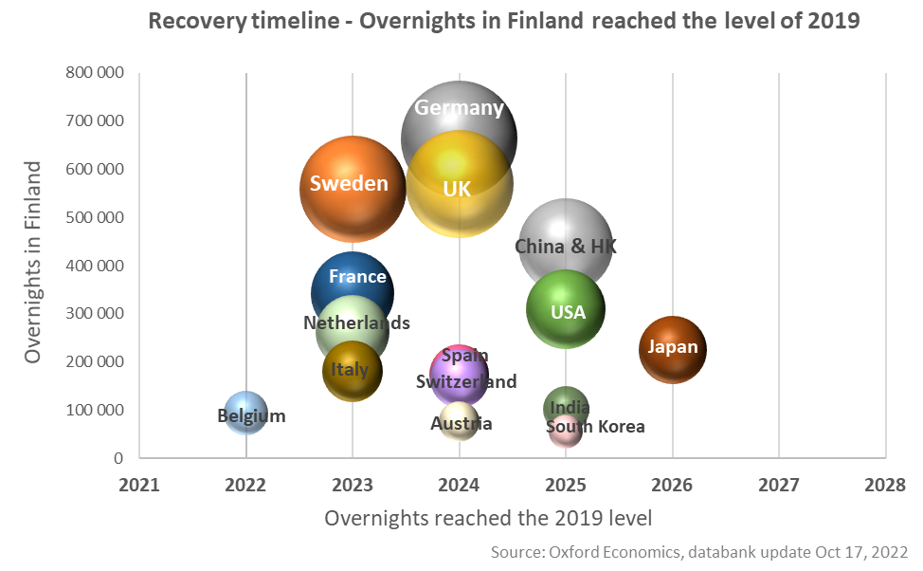
Overnights – Recovery to 2019 levels
Databank update October/2022
 | No. of overnights in 2023 | comp.to 2019
Germany | 569 000 | -14 %
Sweden | 559 400 | 0 %
UK | 491 700 | -14 %
France | 343 700 | 1 %
Netherlands | 295 100 | 13 %
USA | 225 700 | -27 %
Italy | 190 800 | 6 %
Spain | 168 700 | -3 %
Switzerland | 159 800 | -4 %
China | 147 900 | -66 %
Belgium | 117 100 | 25 %
Japan | 104 400 | -54 %
Austria | 68 900 | -10 %
India | 62 900 | -39 %
South Korea | 34 200 | -39 %
Russia will not recover by 2030!
Source: Oxford Economics / Tourism Economics Databank

Slide 18
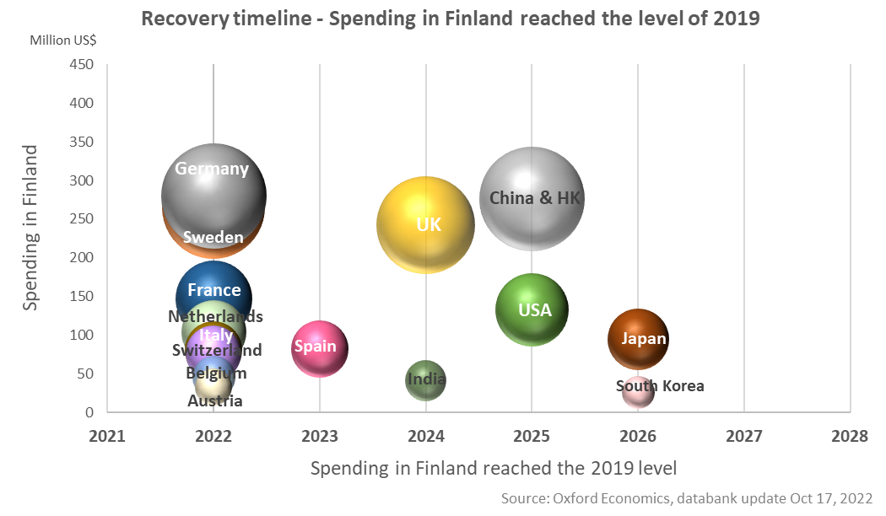
Spending – Recovery to 2019 levels
Databank update October/2022
 | Spending (Million US$) in 2023 | comp.to 2019
Sweden | 311,3 | 17 %
Germany | 276,2 | -1 %
United Kingdom | 229,3 | -5 %
France | 174,2 | 19 %
China | 134,6 | -55 %
Netherlands | 131,1 | 26 %
United States | 108,9 | -18 %
Italy | 96,7 | 20 %
Spain | 89,1 | 9 %
Switzerland | 84,9 | 11 %
Belgium | 66,1 | 46 %
Japan | 48,9 | -48 %
Austria | 34,0 | 4 %
India | 29,3 | -29 %
South Korea | 18,5 | -29 %
Russia will not recover by 2030!
Source: Oxford Economics / Tourism Economics Databank

