Slide 1
South Korea insights
Overnights Finland
Digital Demand – Travel Related Internet Searches
Forward Keys – Flight bookings and Capacity data
Oxford Economics – Recovery Forecast

Slide 2
South Korea – Overnights in Finland 2011-2021
2021
6 000 nights
No. 41 in rankings
YoY change -41%
2019
55 847 nights
2021 vs. 2019 -89%
Total overnights Jan-Sep22 :
16,400
-61% vs. Jan-Sep19
Source: Visit Finland Statistics Service Rudolf, Statistics Finland

Slide 3
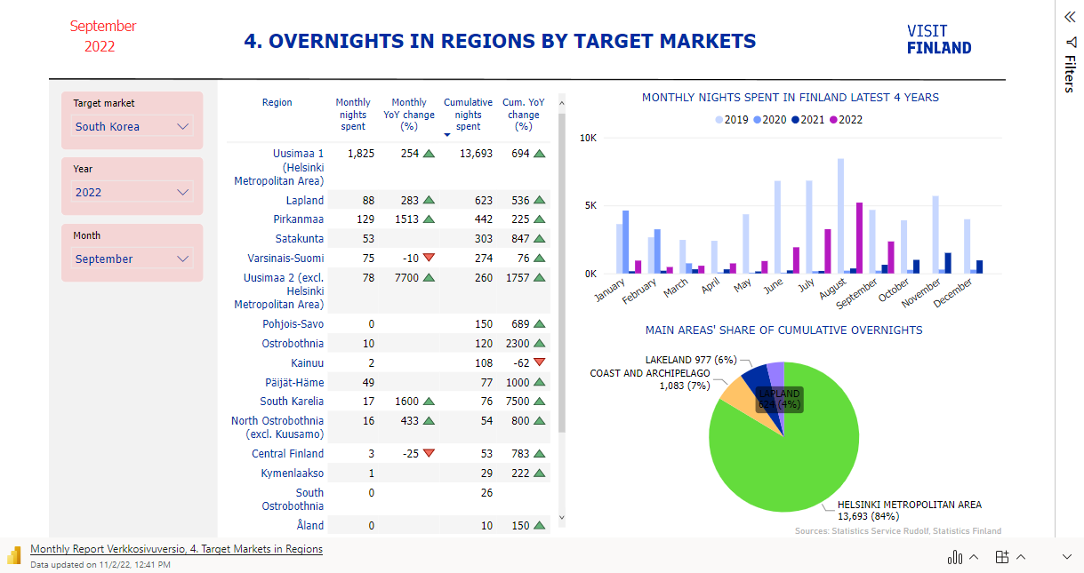

Slide 4
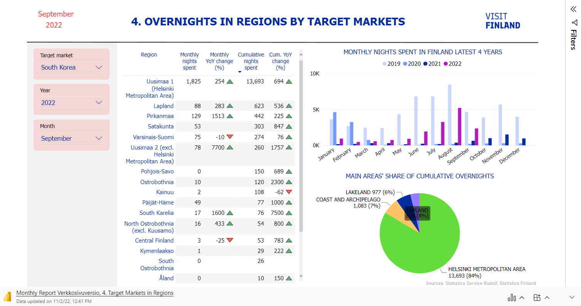
Helsinki region is the biggest area for Koreans in Finland, cumulative overnights this year are nearly 14,000 which is 694% more than in 2021
Helsinki region’s share is 84% of total

Slide 5
Top markets in winter season 2022
And change compared to pre-pandemic
High winter season (12-02)
Top destinations from South Korea
Top10 source markets winter 2021-2022 |  | Dec2018-Feb2019 | Dec2021-Feb2022 | Change 2022 vs. 2019
1. | United Kingdom | 334 900 | 278 600 | -17%
2. | France | 161 700 | 180 300 | +11%
3. | Germany | 151 300 | 133 100 | -12%
4. | Netherlands | 106 700 | 111 300 | +4%
5. | Spain | 59 400 | 55 300 | -7%
6. | Estonia | 58 200 | 47 400 | -19%
7. | Belgium | 30 300 | 45 900 | +51%
8. | Italy | 42 900 | 45 200 | +5%
9. | United States | 53 800 | 39 600 | -26%
10. | Switzerland | 51 800 | 37 800 | -27%
. . . . .
40. | South Korea | 11 200 | 2 400 | -79%
Winter 2021-2022
Helsinki | 600
Espoo | 500
Vantaa | 300
Winter 2018-2019
Helsinki | 5 600
Vantaa | 900
Inari-Saariselkä | 900
Source: Visit Finland Statistics Service Rudolf, Statistics Finland

Slide 6
Top markets in summer season 2022
And change compared to pre-pandemic
High summer season (06-08)
Top destinations from South Korea
Top10 source markets summer 2022 |  | Jun-Aug2019 | Jun-Aug 2022 | Change 2022 vs. 2019
1. | Sweden | 255 200 | 235 800 | -8%
2. | Germany | 270 300 | 229 100 | -15%
3. | United States | 109 900 | 103 800 | -6%
4. | United Kingdom | 90 800 | 74 500 | -18%
5. | Norway | 73 400 | 68 200 | -7%
6. | Estonia | 69 400 | 60 400 | -13%
7. | Russia | 243 400 | 60 100 | -75%
8. | Switzerland | 64 400 | 54 100 | -16%
9. | France | 64 100 | 53 800 | -16%
10. | Netherlands | 62 300 | 52 400 | -16%
. . . . .
27. | South Korea | 22 100 | 10 400 | -53%
Summer 2022
Helsinki | 6 700
Espoo | 1 900
Vantaa | 700
Summer 2019
Helsinki | 17 700
Vantaa | 1 800
Espoo | 800
Source: Visit Finland Statistics Service Rudolf, Statistics Finland

Slide 7
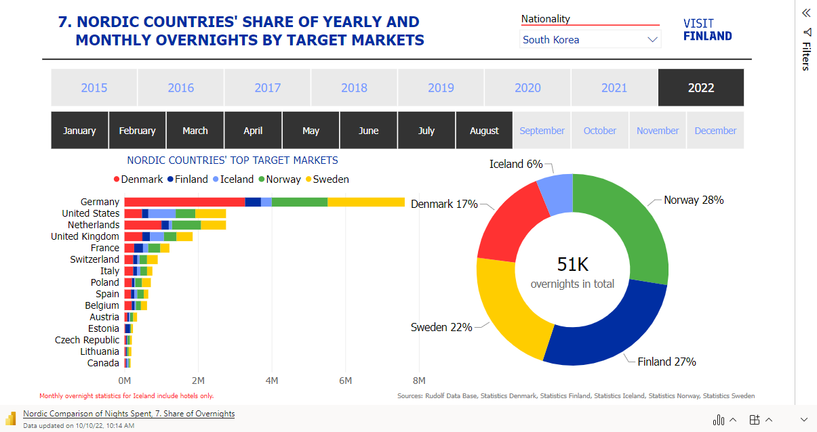

Slide 8
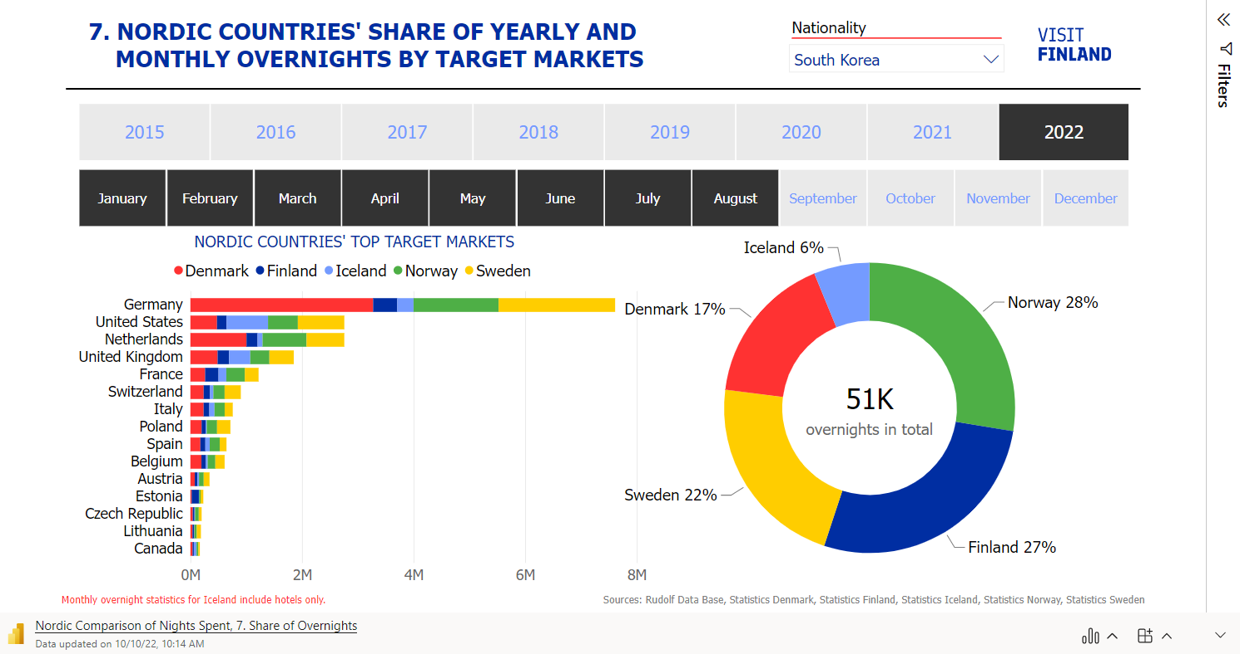

Slide 9
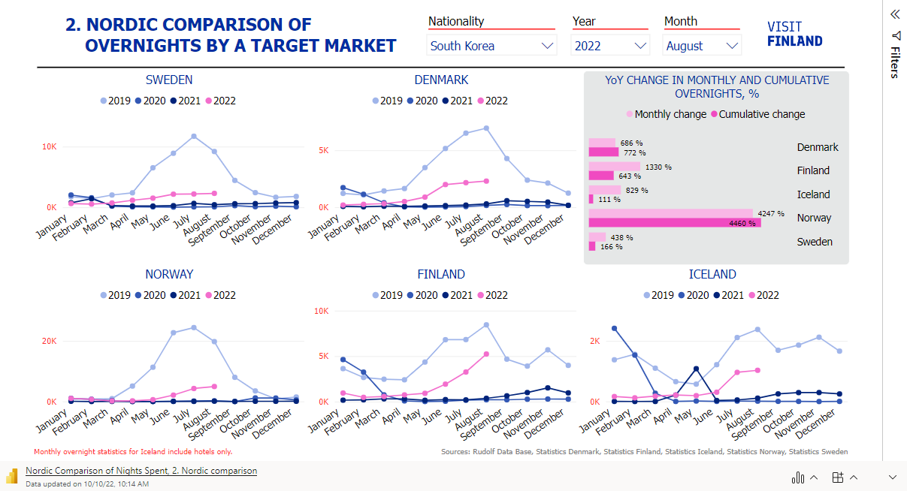

Slide 11

Digital Demand – Travel Related Internet Searches
Q1/2022 – Q3/2022

Slide 12
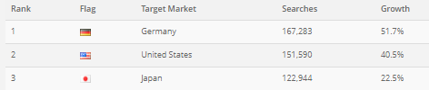
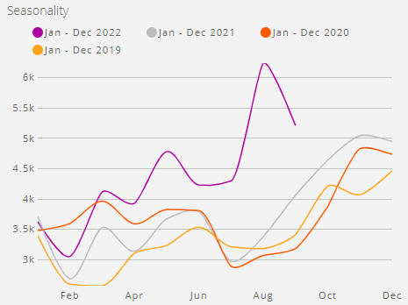
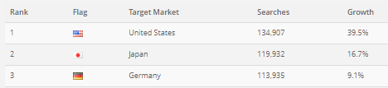
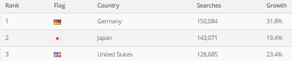
Korean searches in Q1-Q3 2022
Q1/2022
Travel related searches from South Korea have started to increase strongly during this year.
. . . . .
Q2/2022
. . . . .
Q3/2022
. . . . .
Source: D2 Digital Demand

Slide 13
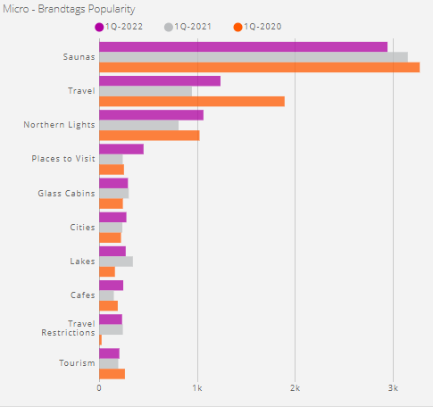
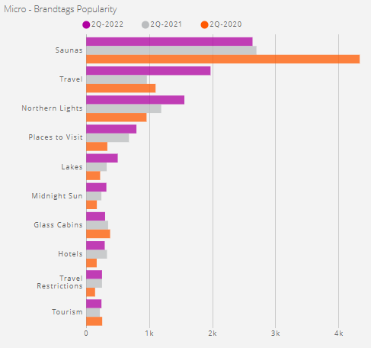
South Korea: Most searched topics
Q1/2022
Q2/2022
Source: D2 Digital Demand

Slide 14
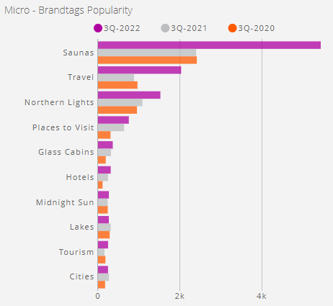
South Korea: Most searched topics
Q3/2022
Travel related searches on Finland from South Korea remain still in a quite low level, but the interest seems to be growing after the travel restrictions have been lifted
Especially interest towards saunas and northern lights is increasing
Source: D2 Digital Demand

Slide 15

ForwardKeys
Seat capacity to Finland
November/2022 – February/2023

Slide 16
Direct flights to Finland November 2022 - February 2023
and change in seat capacity compared to pre-pandemic
From | To | Average weekly frequency
Tokyo (HND) | HEL | 12 → 14
Doha (DOH)** | HEL | 3 → 14
Bangkok (BKK) | HEL | 11
Singapore (SIN) | HEL | 7
Delhi (DEL) | HEL | 7
Seoul (ICN) | HEL | 5-6
Hong Kong (HKG) | HEL | 3
Dubai (DUB) | HEL | 3
Mumbai (BOM) | HEL | 3
Phuket (HKT) | HEL | 1 → 5
Tokyo (NRT) | HEL | 2
Shanghai (PVG) | HEL | 2
Chengdu (CTU) | HEL | 1
Guangzhou (CAN) | HEL | 1
Asia
72 avg. weekly flights
(Share; %YoYPP Var)
(13%; -46%)
USA
16 avg. weekly flights
(Share; %YoYPP Var)
(3%; +16%)
Europe
985 avg. weekly flights
(Share; %YoYPP Var)
(84%; -21%)
From | To | Avg. weekly frequency
New York (JFK) | HEL | 7
Dallas (DFW) | HEL | 3-4
Los Angeles (LAX) | HEL | 3
Miami (MIA)* | HEL | 3 → 2
*) MIA starts end-Nov with 3 weekly flights, end-Jan to 2 weekly flights
**) flight frequency to 14 from mid-Dec
Source: Destination Gateway by ForwardKeys
Database update 25-Oct

Slide 17
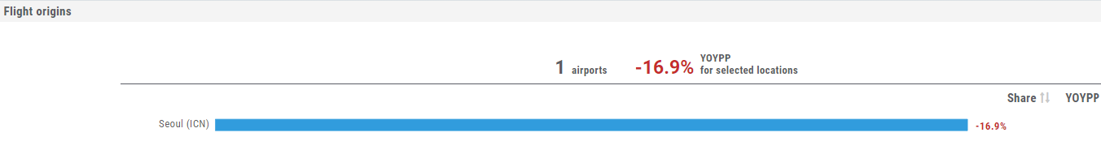
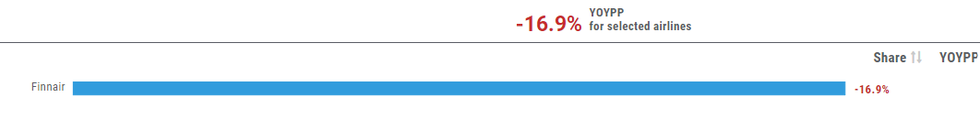
Direct flights from South Korea to Finland Nov 2022 - Feb 2023
Comparison with pre-pandemic
Seat capacity from Seoul to Finland is getting closer to the pre-pandemic levels
However, Finnair has postponed the opening of the Busan route which was in their plans prior to the Russian attack to Ukraine
Source: ForwardKeys Destination Gateway

Slide 18

Oxford Economics –Overnights & Spending
Recovery forecasts

Slide 19
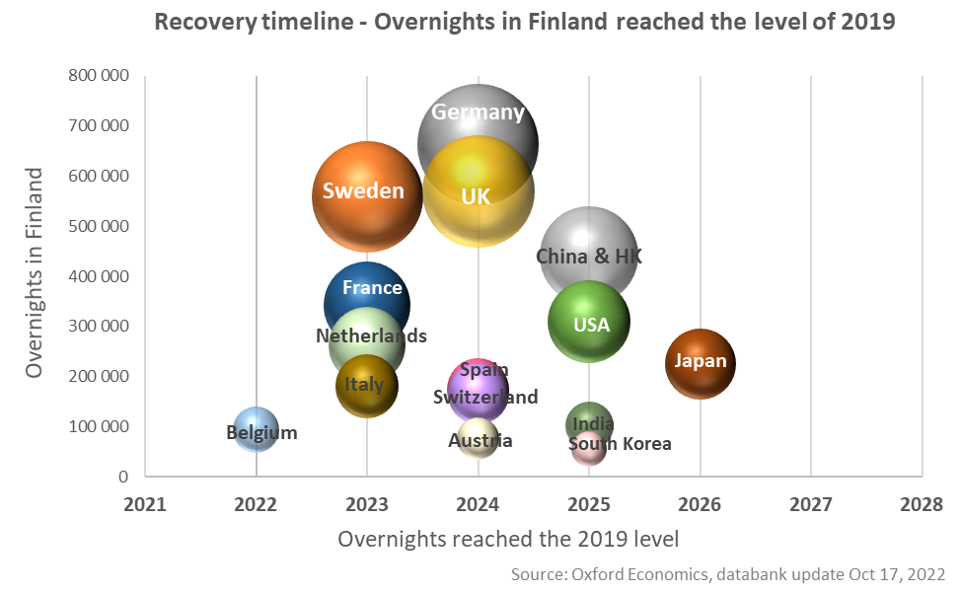
Overnights – Recovery to 2019 levels
Databank update October/2022
 | No. of overnights in 2023 | comp.to 2019
Germany | 569 000 | -14 %
Sweden | 559 400 | 0 %
UK | 491 700 | -14 %
France | 343 700 | 1 %
Netherlands | 295 100 | 13 %
USA | 225 700 | -27 %
Italy | 190 800 | 6 %
Spain | 168 700 | -3 %
Switzerland | 159 800 | -4 %
China | 147 900 | -66 %
Belgium | 117 100 | 25 %
Japan | 104 400 | -54 %
Austria | 68 900 | -10 %
India | 62 900 | -39 %
South Korea | 34 200 | -39 %
Russia will not recover by 2030!
Source: Oxford Economics / Tourism Economics Databank

Slide 20
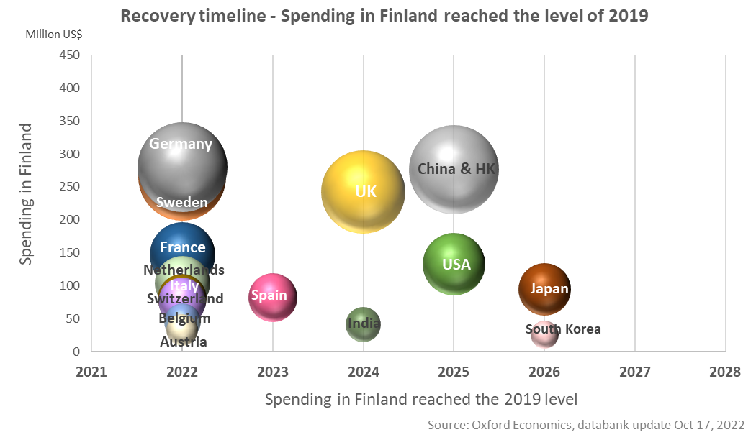
Spending – Recovery to 2019 levels
Databank update October/2022
 | Spending (Million US$) in 2023 | comp.to 2019
Sweden | 311,3 | 17 %
Germany | 276,2 | -1 %
UK | 229,3 | -5 %
France | 174,2 | 19 %
China | 134,6 | -55 %
Netherlands | 131,1 | 26 %
USA | 108,9 | -18 %
Italy | 96,7 | 20 %
Spain | 89,1 | 9 %
Switzerland | 84,9 | 11 %
Belgium | 66,1 | 46 %
Japan | 48,9 | -48 %
Austria | 34,0 | 4 %
India | 29,3 | -29 %
South Korea | 18,5 | -29 %
Russia will not recover by 2030!
Source: Oxford Economics / Tourism Economics Databank

